Slide 1

Portfolio Analysis Project
Group 2: Pooja & Negar

Slide 2
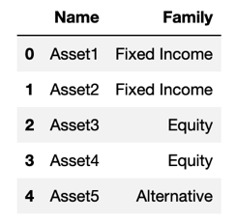
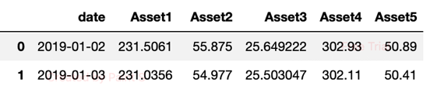
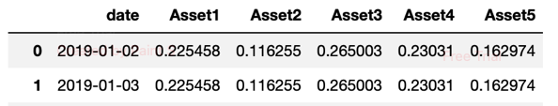
Project Overview
Data sources:
Asset information: Asset by their categories
Asset price: Pricing information for various financial assets
Portfolio Asset Weight: Daily weights of each asset in the portfolio
wi​= (Value of Asset i / Total Portfolio Value)×100%
Portfolio analysis:
A systematic way to evaluate investment portfolios to optimize asset allocation and management.

Slide 3
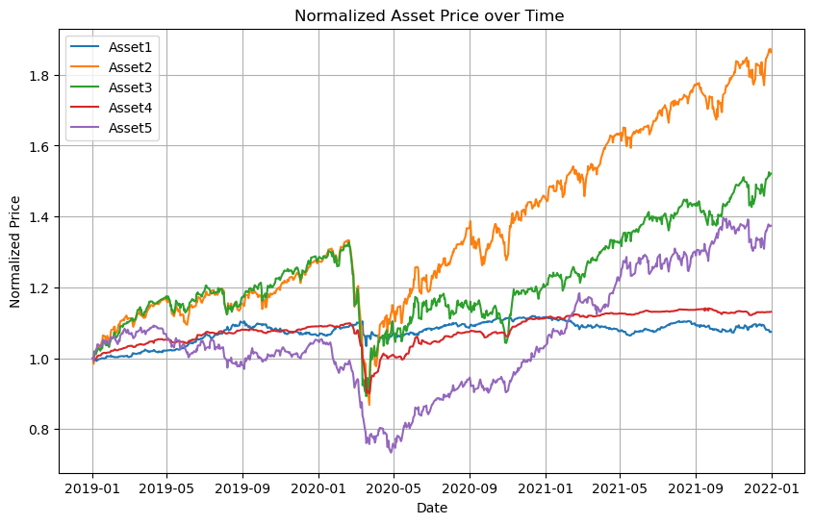
Asset Price over time:

Slide 4
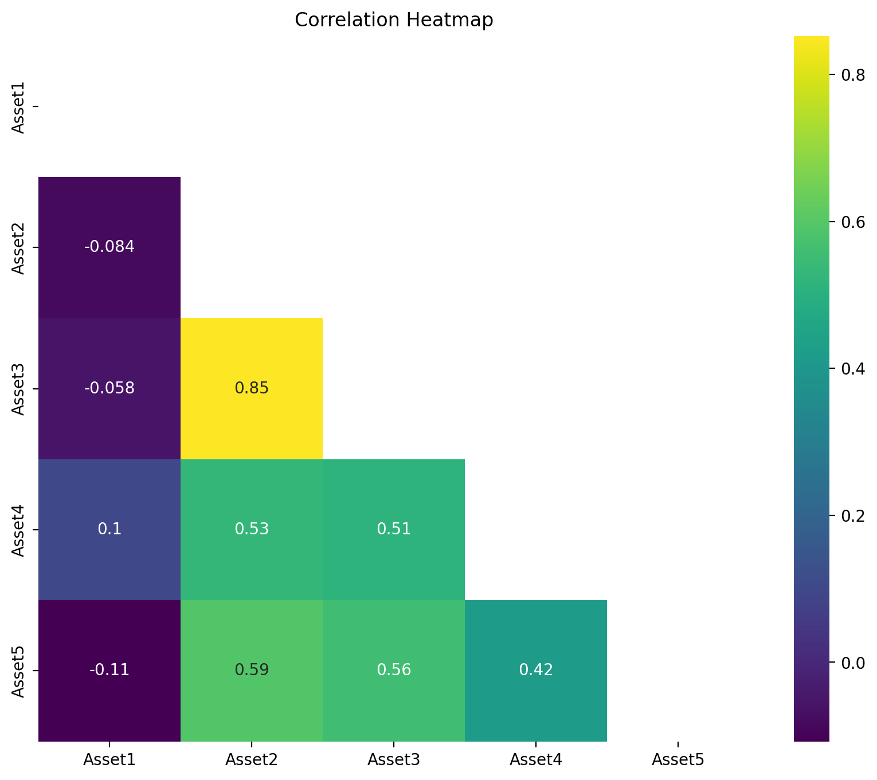
Daily Return of all Assets:
Findings:
Asset 1 & Asset 3 have the lowest correlation
Asset 2 & Asset 3 have highest correlation
Asset 1 have less correlation with other Assets

Slide 5
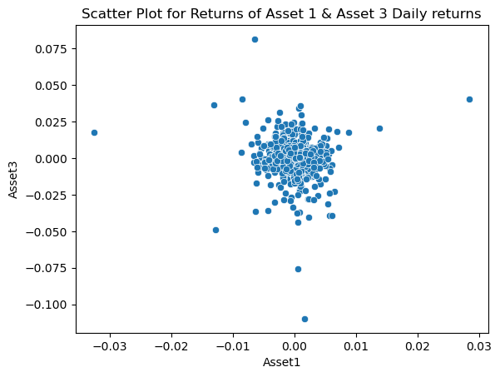
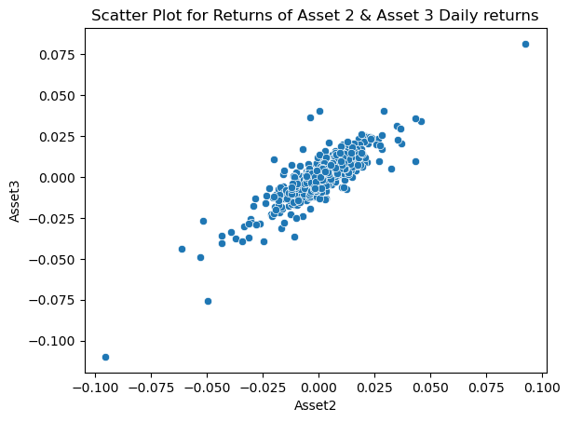
Daily Returns of 2 Assets
Asset 1 & Asset 3 -lowest correlation: -0.058
Asset 2 & Asset 3 -highest correlation: 0.84

Slide 6
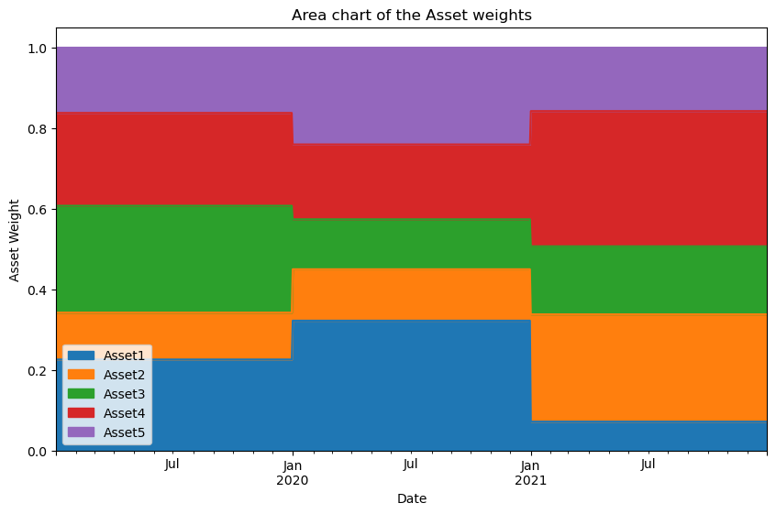
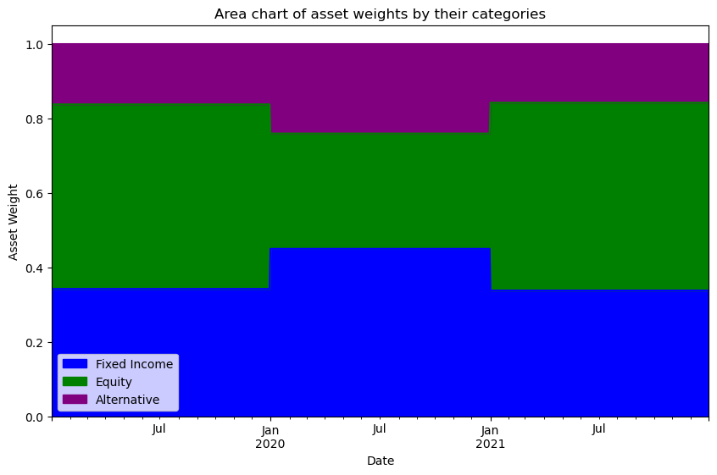
Portfolio Analysis: Asset weights

Slide 7
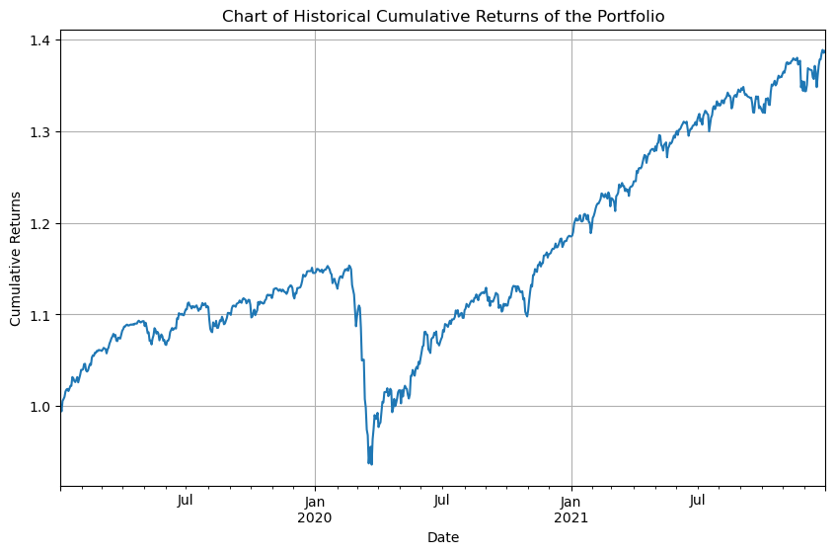
Portfolio Analysis: Cumulative Return
The cumulative return of a portfolio:
The total return earned on the entire portfolio over a specified period, taking into account the performance of all assets held within the portfolio.

Slide 8
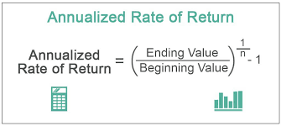
Annualized Return:
Annualized return, also known as the compound annual growth rate (CAGR), represents the average annual rate of return earned on an investment over a specified period of time.
Portfolio's Annual return: 0.12

Slide 9
Annualized Volatility:
Annualized volatility, also known as the annualized standard deviation, is a measure of the dispersion of returns for a financial asset over a specified period of time, typically expressed as an annualized percentage.
Portfolio's Annual return: 0.085

Slide 10
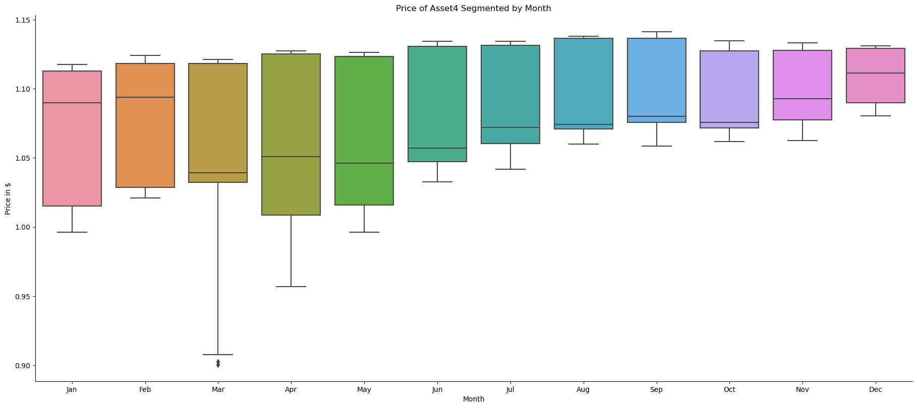
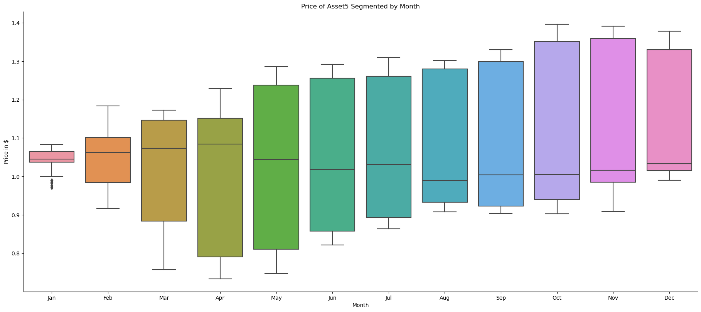
Insights:

Slide 11
Conclusions:
There is a significant price drop in almost all assets in 2020 (Feb-May)
Asset 1 & Asset 3 have the lowest correlation Asset 2 & Asset 3 have highest correlation.
During the drop in 2020 Fixed income (mainly Asset 1)and Alternative assets (Asset 5) have the most asset weights.
Portfolio annual return is 0.12 which indicates that the portfolio has experienced growth in value over the years.
Portfolio anuual volatility is 0.085 which indicates the level of risk associated with the portfolio's returns over a one-year period.

Slide 12

Thanks for your kind attention

